Slide 1
Java Threads
And why they’re awesomesauce.
Sean P Madden

Slide 2
Concurrency
Running multiple “Threads” of executable code at the same time
What does a computer do synchronously?
Play Music
Compile Code
Watch YouTube
This is known as “Concurrent Software”

Slide 3
Processes and Threads
Process:
Self-Contained Execution Environment
Each process has it’s own memory space
JVM Is a single process
Threads:
Run within processes
Every process has at least one
public static void main(String[] args){} ?
Share memory with the parent process
Have access to objects within other processes

Slide 4
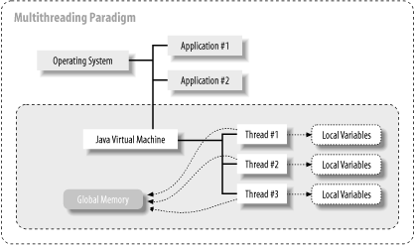
Processes and Threads

Slide 5
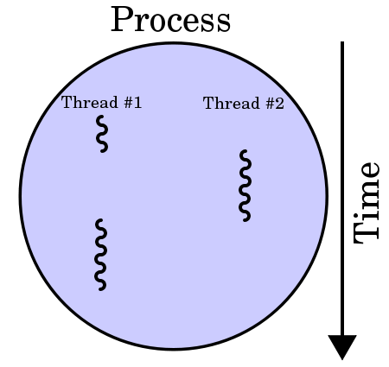
Multi Threaded Applications

Slide 6
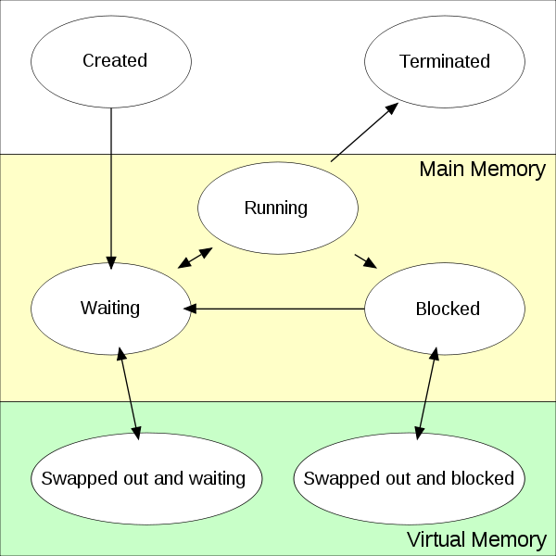
Processes on a Single Processor

Slide 7
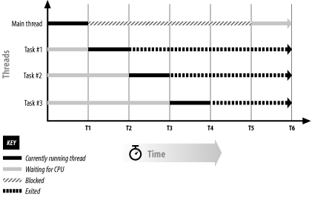
Thread Scheduling

Slide 8
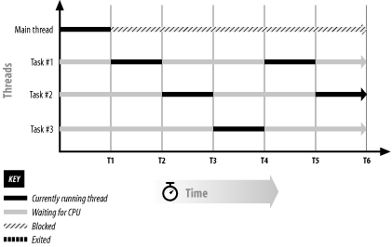
Thread Scheduling Redux

Slide 10
Thread Objects
Threads are associated with java.lang.Thread
public abstract void run(){}
Two ways to create a thread
Implement Runnable
Extend Thread

Slide 11
Implement Runnable
public class HelloRunnable implements Runnable {
public void run() {
System.out.println("Hello from a thread!");
}
public static void main(String args[]) {
Thread t = new Thread(new HelloRunnable());
t.start();
}
}

Slide 12
Extend java.lang.Thread
public class HelloThread extends Thread {
public void run() {
System.out.println("Hello from a thread!"); }
public static void main(String args[]) {
Thread t = new HelloThread();
t.start();
}
}

Slide 13
Which to use?
Depends on Application
Implementing Runnable is more general
Leaves class open to extend other classes
Extending Thread is more powerful
Full access to all Thread’s methods within the ‘run’ method.

Slide 14
Pausing a Thread
Thread.sleep(long milis);
Throws a runtime exception when interrupted

Slide 15
Interrupts
Throw an InterruptedException when thread is in following states:
Wait()
Join()
Sleep()
Thread t = new Thread();
t.start();
t.interrupt();

Slide 16
Joins
Pause execution until the target thread executes
If interrupted, throws an InterruptedException

Slide 17
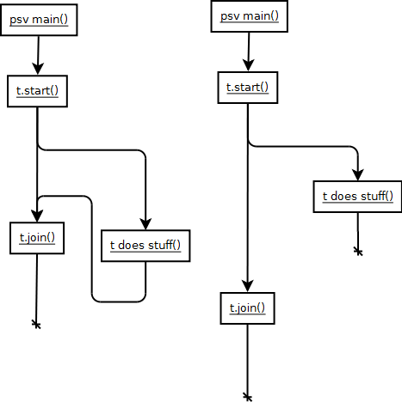
Joins

Slide 18
SimpleThreads : Example

Slide 19
The Java Monitor
All objects have the concept of a ‘Monitor’
Provides a way to delegate who has access to execute
Threads can take ‘Ownership’ of the monitor to perform concurrent activities
Synchronization
Waiting

Slide 20
Synchronization
Method keyword
Synchronized Block on Class
Synchronized Block on Object

Slide 21
Synchronized Methods

